Slide 1
Storytelling Group Project
Team T4: Video Games

Slide 2
Week 5

Slide 3
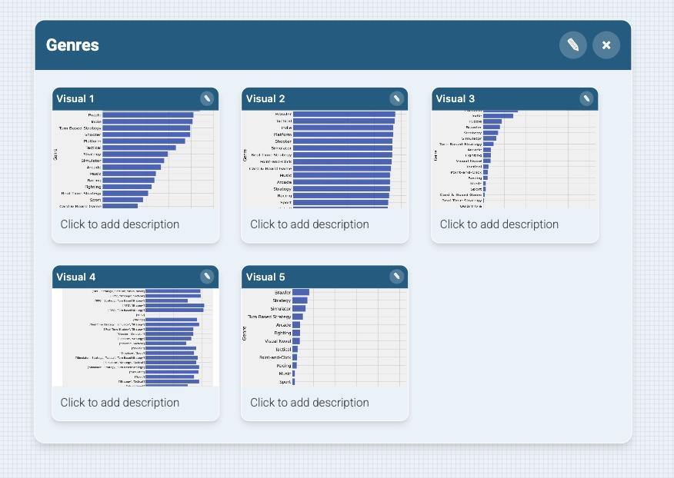
Storyboard - Aria
We made a storyboard for genres because it includes what we compared with genre’s like wishlists, rating, the length of each review per genre, the count of each genre per game. This data can help us better understand what genre is the most popular based off this data. Looking at our questions from the first week, we are focusing on genres and these graphs can help us understand which is is top 3 or top 5

Slide 4
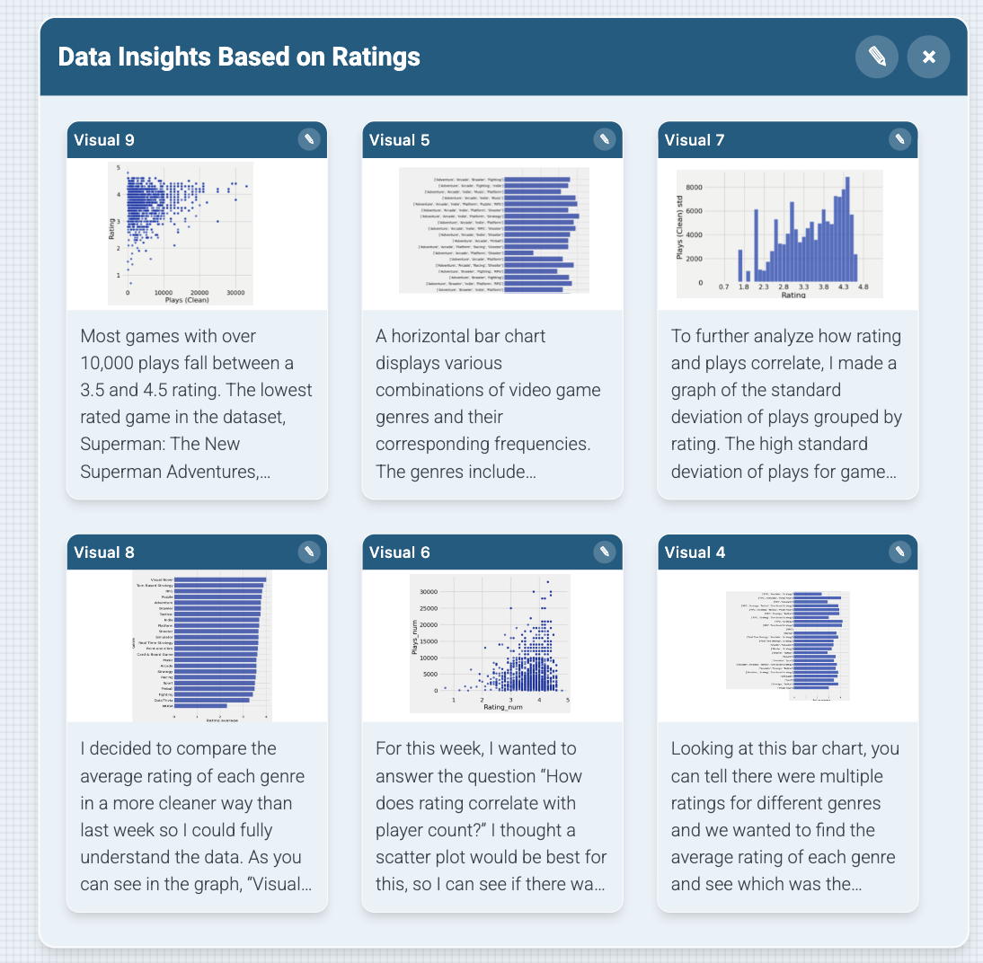
Storyboard - Camila
We made another storyboard for ratings because we each had a question related to ratings of certain games. Whether the rating correlated with player count, game genre, etc., we all looked at the dataset and created graphs to show our findings.

Slide 5
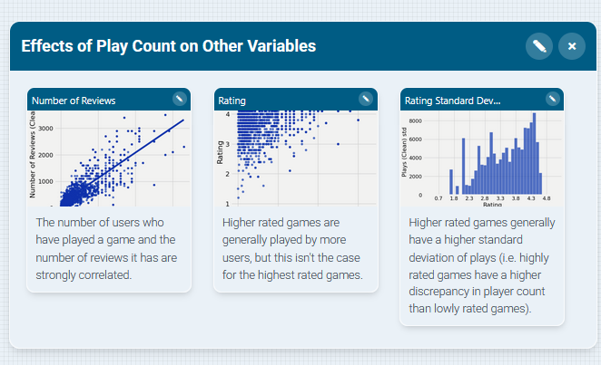
Storyboard - Casey
We made another storyboard focused on how high play count correlates with other variables.
This data will be useful for determining how the popularity of a games can affect its other metrics, making it possible to potentially filter out noise from other types of analysis.

Slide 6
Progress
This week, we were able to come up with a storyboard that connected certain things together and make more sense of our data instead of it being multiple factors of other things. I think we can start to clean it up next week and maybe add some other data based off what our plan is as a group.
One challenge we need to overcome is just cleaning up the data and making it more into a story.

Slide 7
Week 4

Slide 8
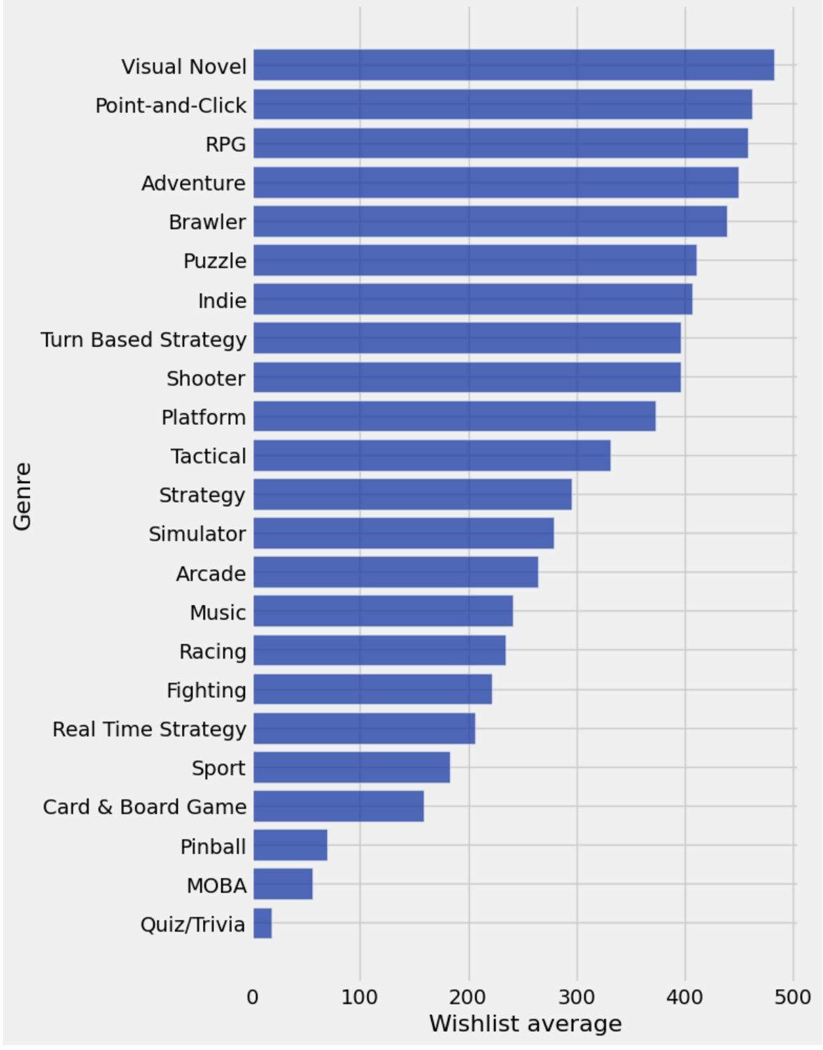
Aria’s Mini Update
I wanted to see the average number of wishlist additions per genre. That means it looked at multiple games and averaged it. Looking at this data, you can see players are more excited about games that are narratives and story driven and have that on their wishlist the most along with Point and Click, RPG, Adventure, and Brawler. You can also see from the graph that quiz/trivia, MOBA, an Pinball are the least interested in with under 100 being on the wishlist.

Slide 9
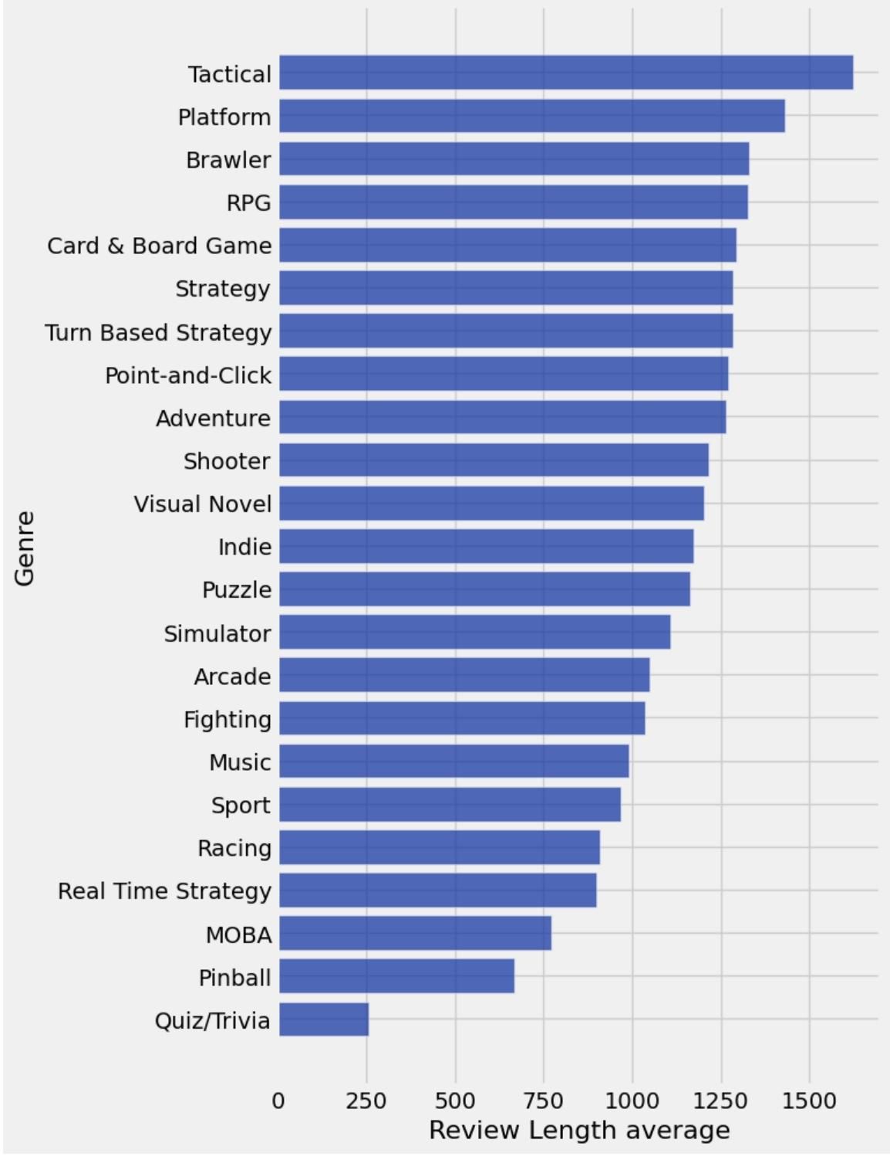
Aria’s Mini Update
I wanted to look at the length of each review and average it per genre to see if that made a difference in what was more popular. Looking at the graph, you can see that for Tactical, people had a lot to say about it and seems the most popular in terms of reviews. Quiz/Trivia seem to have the least amount of reviews and shows that it still remains unpopular.

Slide 10
Feedback Analysis
Aria - Looking at my feedback from last week. Visual novel surprised me because I didn’t expect it to be the highest in rating average, I thought adventure or RPG would be up there.

Slide 11
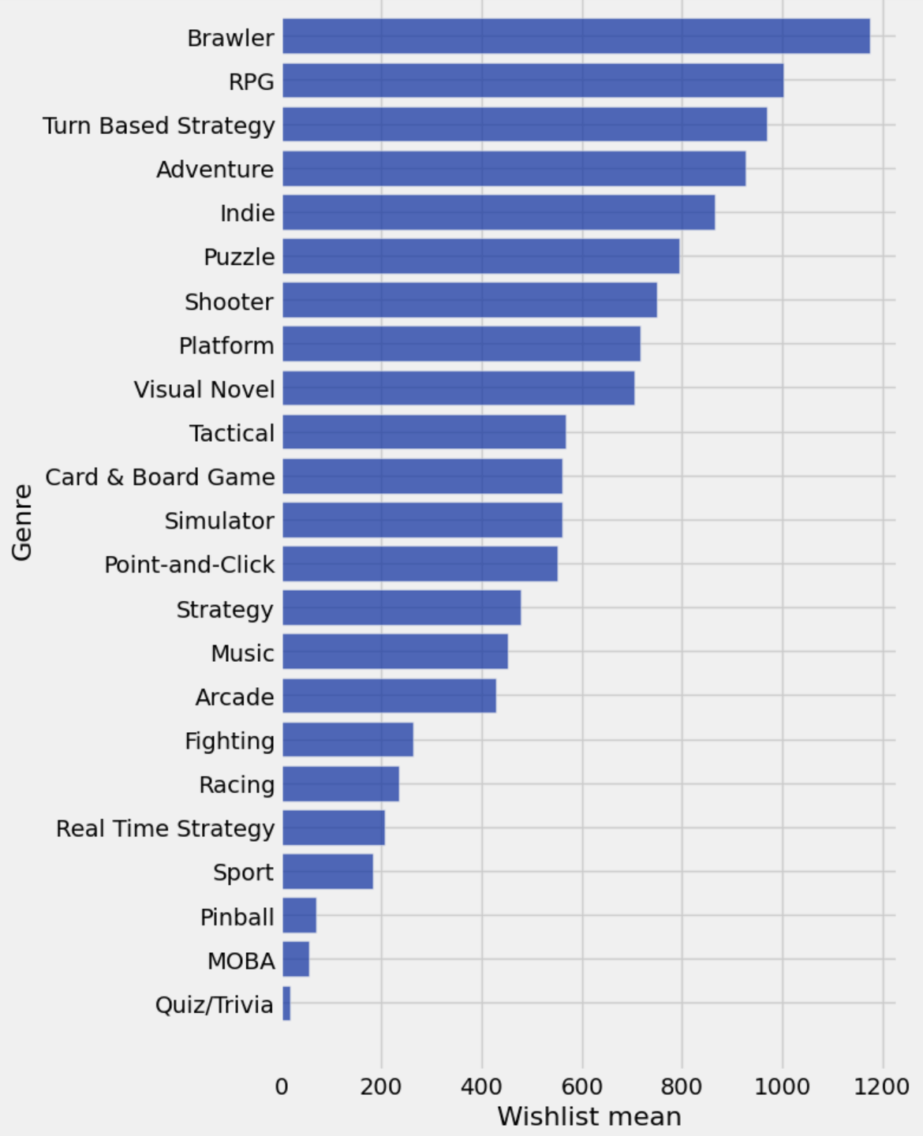
Camila’s Mini Update 1
This week I wanted to see which genres have the most wishlisted games? To do this, I expanded the genres and the wishlist values, then calculated the average.
From the bar graph, the Brawler genre has the highest games that players put in their wishlist. The other genres with a high average is RPG, Turn Based Strategy, Adventure, and Indie.

Slide 12
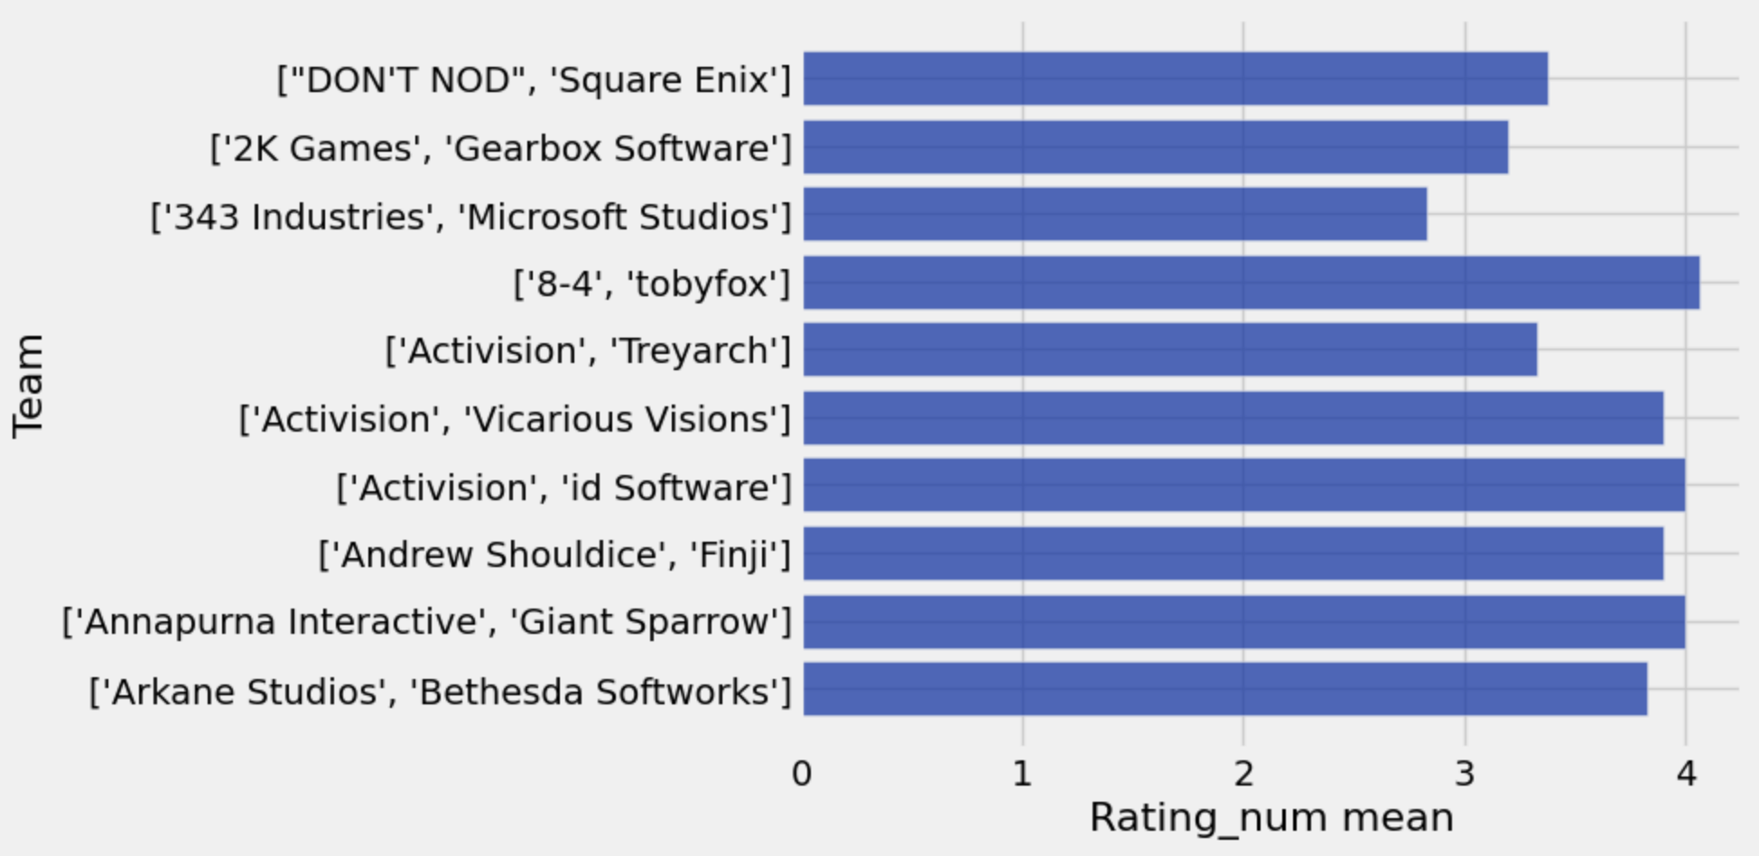
Camila’s Mini Update 2
While looking at the table’s labels, “Team” caught my eye, since I haven’t created a question for that aspect of the data set. So this week I also wanted to see which developers make the highest-rated games?
From this graph, games made by TobyFox, Square Enix, Activision, etc. have high rated games.

Slide 13
Feedback Analysis
After looking at the feedback, I’ve included the horizontal axis labels and taken all the other comments into consideration. I made sure to think about them when doing my updates.

Slide 14
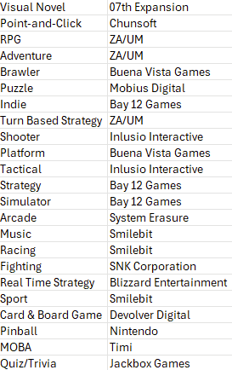
Casey’s Mini-Update
I created a table with the development team corresponding to the highest average rating for each genre of game. The list has several indie developers with only one or a few games published such as Bay 12 Games, ZA/UM, and 07th Expansion. Several appear multiple times because they have one or a few games that are very highly rated with multiple genres, so they appear as the highest rated developer for those genres.

Slide 15
Feedback Analysis
Because of the feedback from last week, I realized that expressing the top developers for each genre of game in a graph was unfeasible. Using a table to only show the highest rated developer for each genre conveys much less information, but should be more digestible because of that. However, this is still a flawed approach because it boosts the ranking of developers who have only published one or a few games in a particular genre.

Slide 16
Progress
This week, we further analyzed data related to each genre of game and the way players interact with them. We also found more data insights about how the teams creating the highest-ranked games, within and outside the context of the genre their games are in. We once again used JupyterHub for our analyses.
One challenge we still need to overcome is forming more cohesive data narratives using multiple types of data. We have found many interesting insights from the data so far, but have yet to connect most of them in meaningful ways.

Slide 17
Week 3

Slide 18
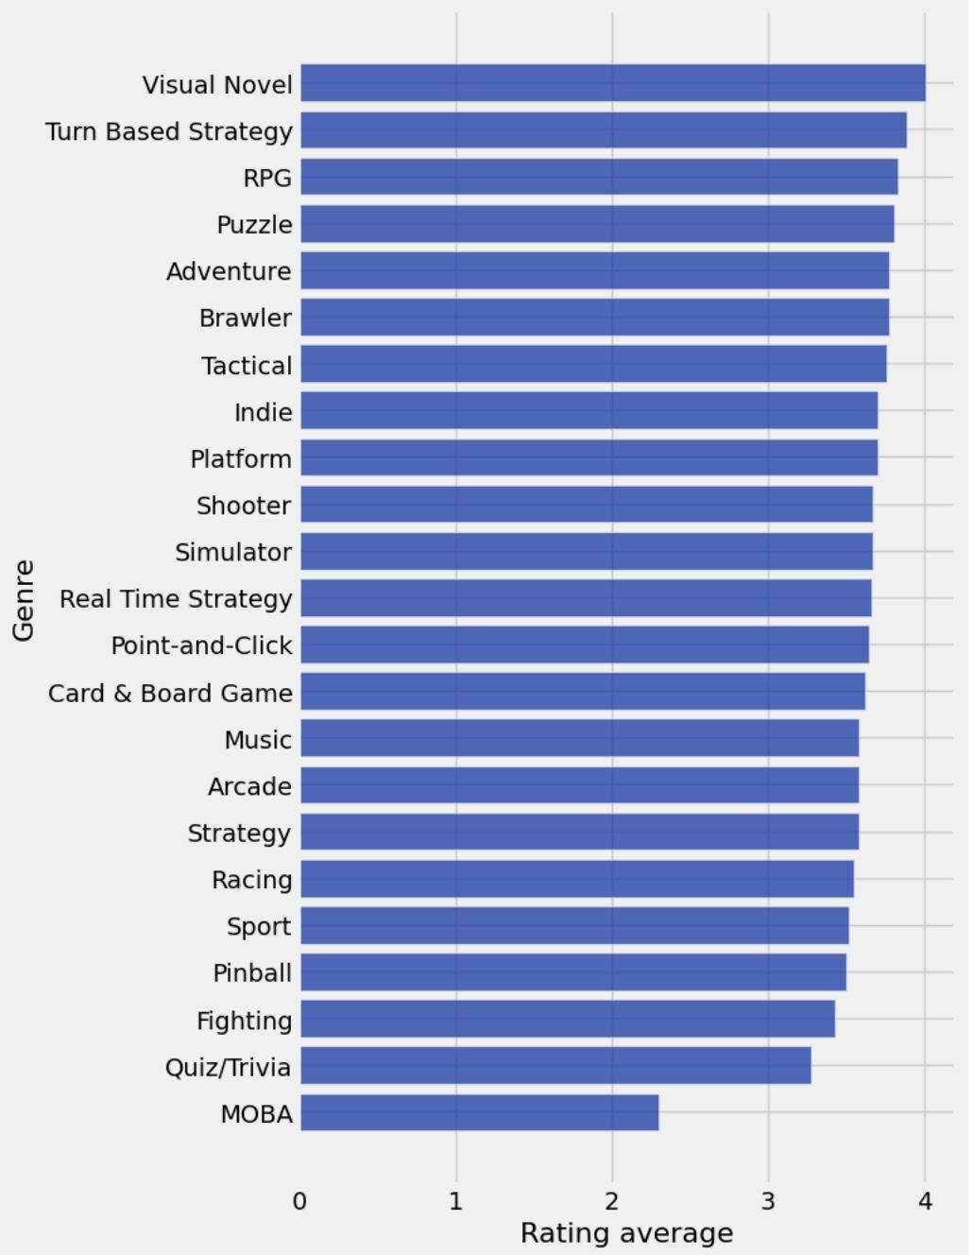
Aria’s Mini Update
I decided to compare the average rating of each genre in a more cleaner way than last week so I could fully understand the data. As you can see in the graph, “Visual Novel” has the highest rating average which is surprising. “MOBA” has the worst rating. Most of the games are similar in rating and are not to far off eachother but this graph helps depict which is the most popular to the least popular

Slide 19
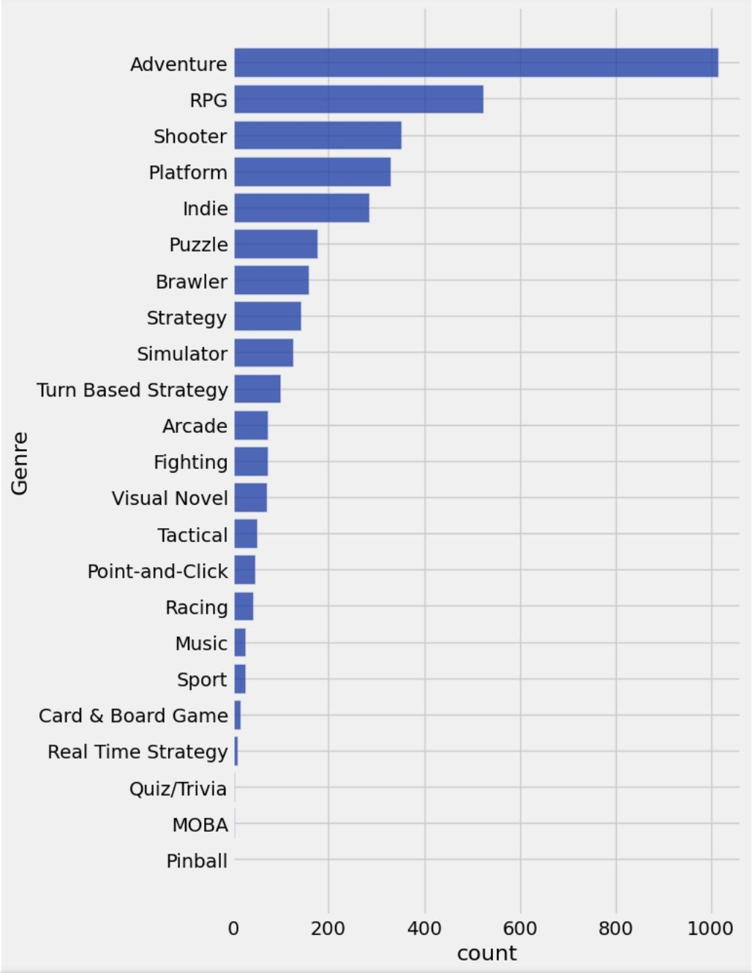
Aria’s Mini Update
I wanted to compare which genres appear most frequently across all games? I created a bar chart to figure that out. You can see that Adventure appears in over 1000 games and is the most popular genre. You can also notice that the genre “Real Time Strategy” is the not found in many games and seems to be the least popular. Lastly, you can notice that “Quiz/Trivia”, “MOBA”, and “Pinball” are not even included in any games so they are at a 0.

Slide 20
Feedback Analysis
Aria - Looking at my feedback from last week, I simplified my data to get a better understanding and added another insight. It was useful because the simplified data is definitely easier to understand. I am seeking feedback on any improvements I could make.

Slide 21
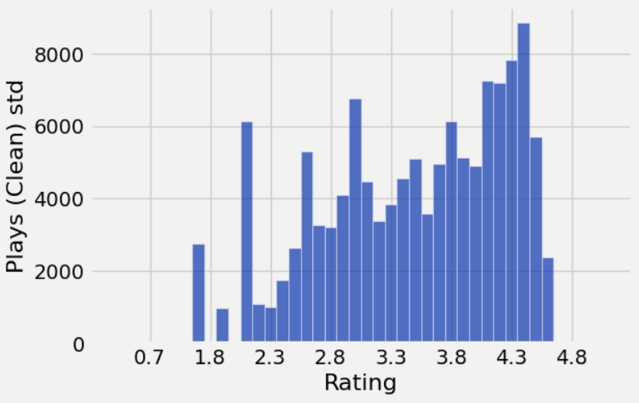
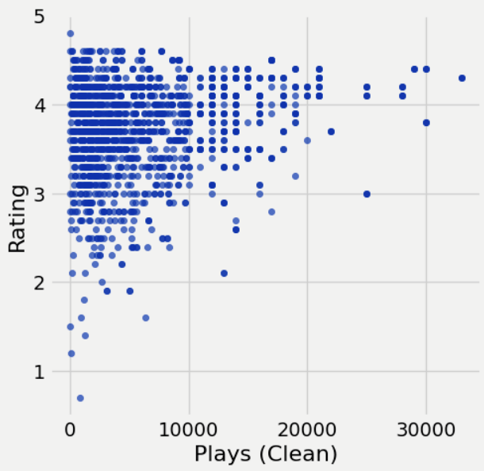
Casey’s Mini-Update 1
To further analyze how rating and plays correlate, I made a graph of the standard deviation of plays grouped by rating. The high standard deviation of plays for games with high ratings indicates that those games have a high deviation in how many people play them, meaning that there are many high rated games played by many people, and many played by only a few people. Games with ratings of 1.8 and 2.3 seem to have the lowest deviation, and games with a 4.4 rating have the highest deviation. Interestingly, games with a rating of 4.6, the highest in this dataset, seem to have a very low standard deviation. The graph comparing plays and rating shows that all of these games have less than 10,000 plays. This seems to reject my earlier observation that games with high ratings tend to have more plays, even though the games with the most plays usually have high ratings.

Slide 22
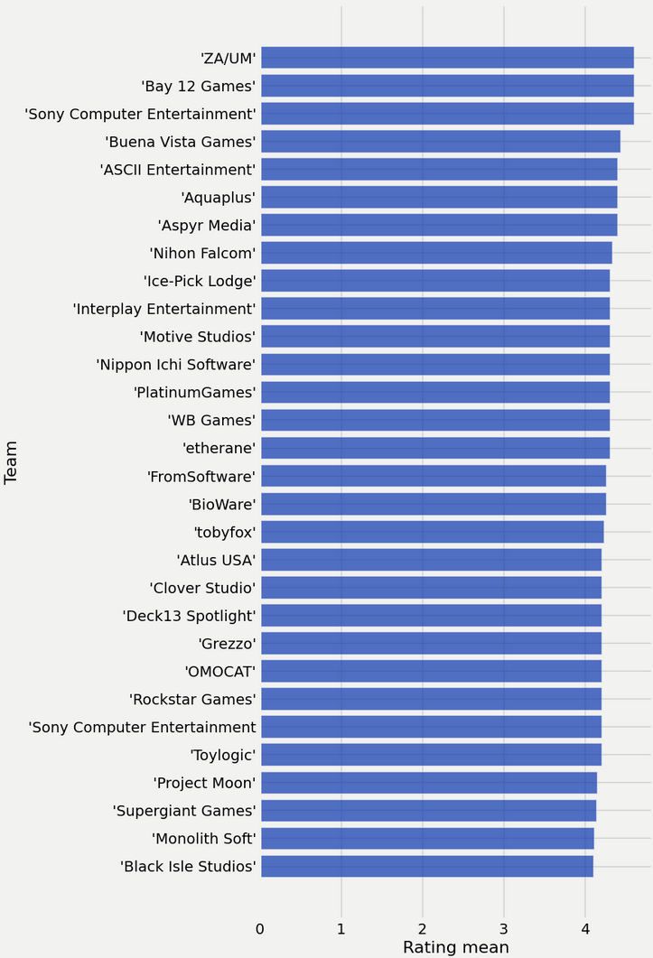
Casey’s Mini-Update 2
I thought it might be interesting to find data on which developers have the highest rated games in each genre. I’ve created a chart of the average ratings of games within the RPG genre by developer. Because of number of developers who have created RPGs, it isn’t feasible to include them all in one graph, so only the top 30 are displayed here. The top developer in the list, ZA/UM, has only released one game (as well as several ports and a remaster of it listed as separate games.) The success of this one game has propelled them to the top of the list. This is also true of OMOCAT.

Slide 23
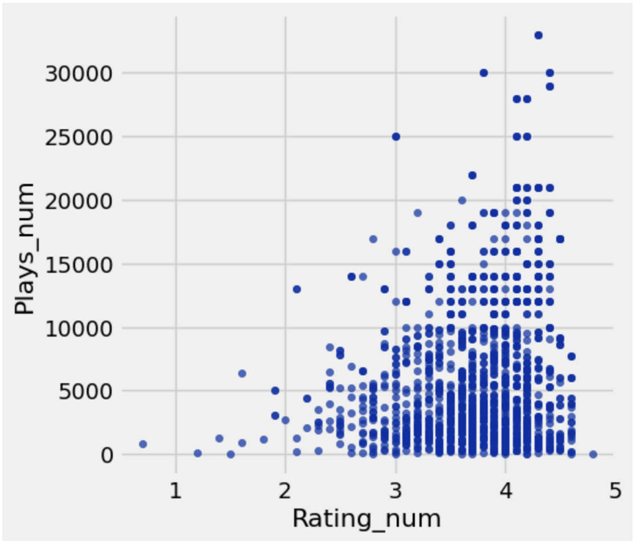
Camila’s Mini-Update
For this week, I wanted to answer the question “How does rating correlate with player count?” I thought a scatter plot would be best for this, so I can see if there was a positive or negative correlation. Before that, I had to convert the strings in the data (“K” for a num in the thousands and “M” for a num in the millions) to actual numbers. In the graph, there seems to be a positive correlation with the play_num increasing as the rating_num increases from 1-4. This could mean that there’s a positive relationship between ratings and player count.

Slide 24
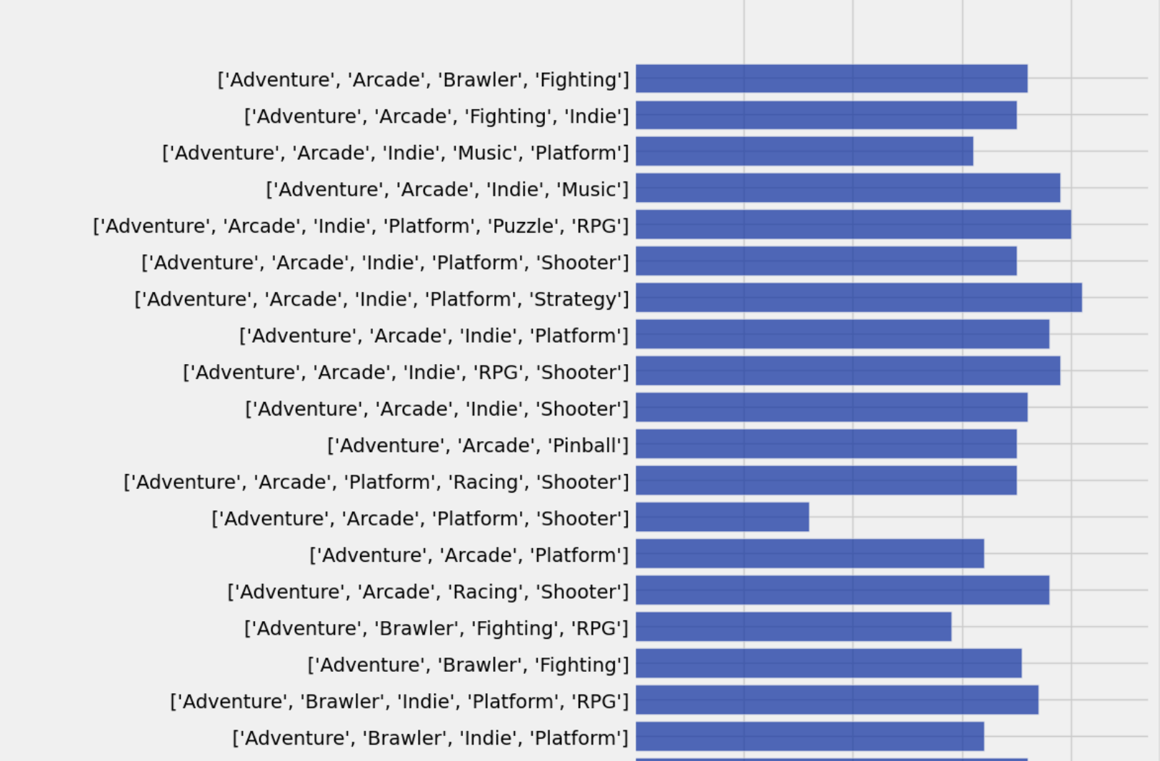
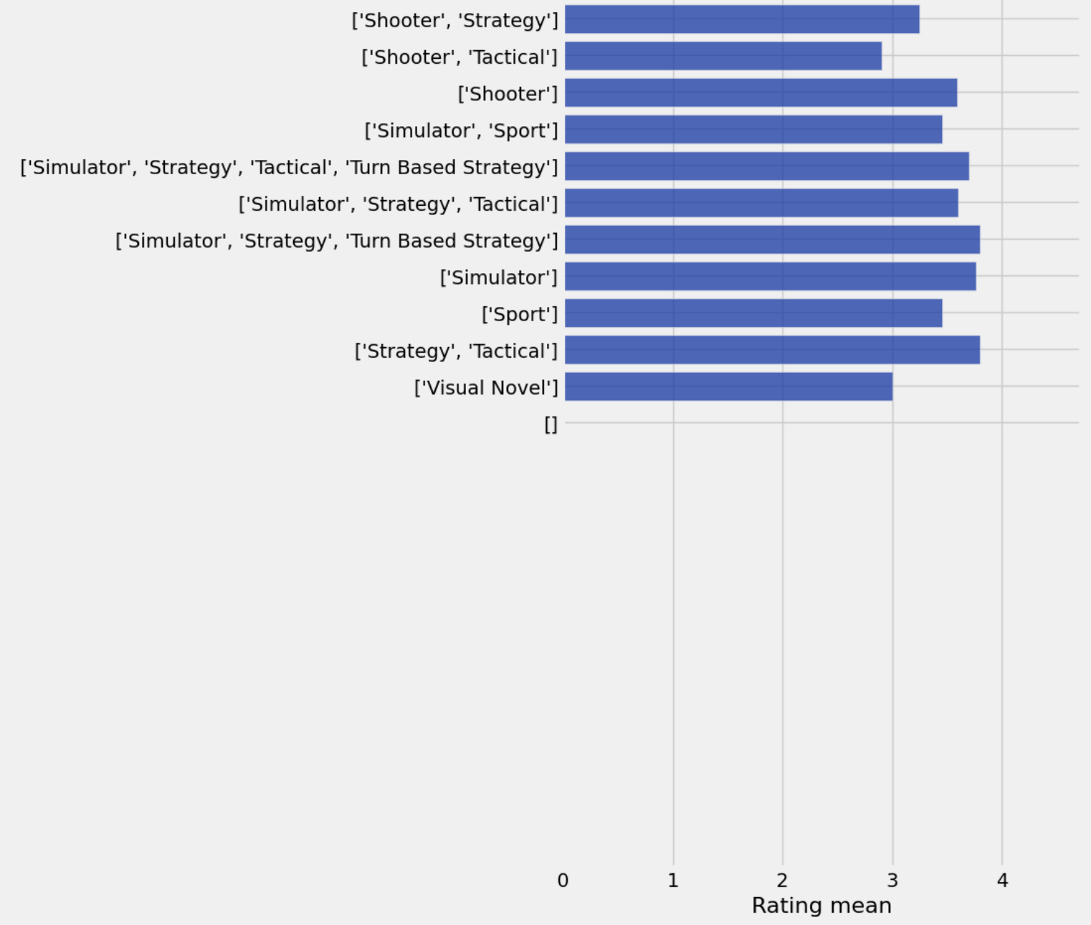
Camila’s Mini-Update 2
I also wanted to answer the question “Which genres have the highest average ratings?” So I grouped all the games’ genres and caluated the mean of each one. Then I sorted then so that only the games with a rating of >4 were shown, the created a bar graph to so my results. It created a really long list, so in this slide I only included a picture of the first 18 genre sets, and put the last few genres in the second picture.
It looks like games that have an Adventure genre perform really well, with the rating average ranging from 3-4. Other games that don’t have Adventure, and have a Shooter, Simulator, or Visual Novel based game don’t do as well.

Slide 25
Feedback Analysis
Camila - Looking at my feedback from last week, I added another insight to the slide deck answering another question.

Slide 26
Progress
Just like last week, we accomplished answering important questions that can help us understand and answer our questions better. Some obstacles we ran into was just figuring out how to answer the question when looking to compare two items in the table. Overall, there wasn’t many obstacles to overcome this week. We used jupyterhub to create our graphs to answer our questions.

Slide 27
Week 2

Slide 28
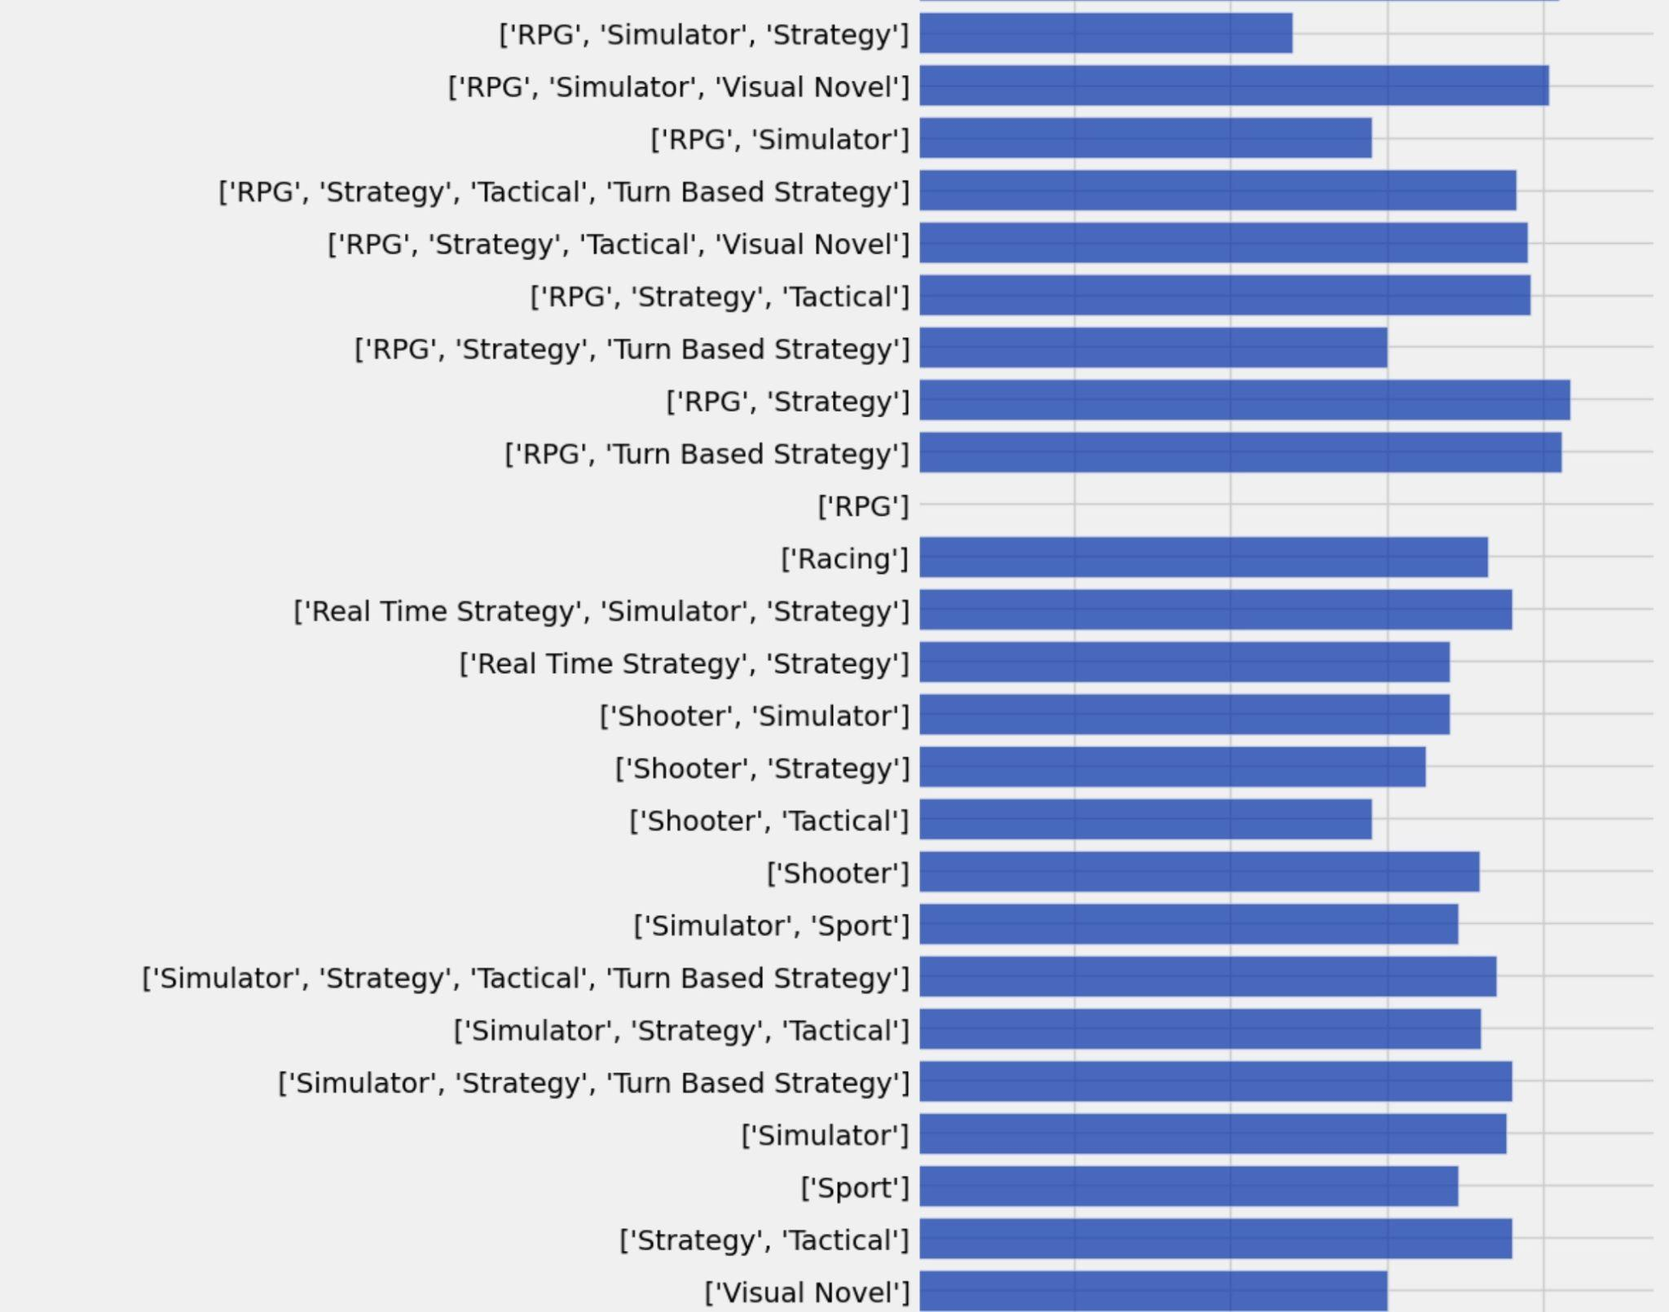
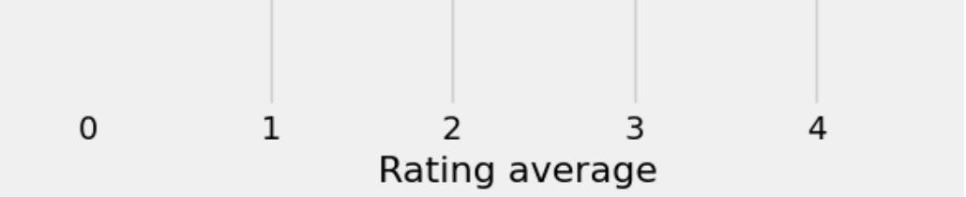
Aria’s Mini Update
Looking at this bar chart, you can tell there were multiple ratings for different genres and we wanted to find the average rating of each genre and see which was the highest rating. This is not all of the ratings because there were too many genres to fit into this slide but this is what I was able to use to figure out the average ratings of each genre. I think this data should be included in the data story since it is one our questions.

Slide 29
Casey’s Mini-Update 1
Most games with over 10,000 plays fall between a 3.5 and 4.5 rating. The lowest rated game in the dataset, Superman: The New Superman Adventures, usually referred to as Superman 64, has a rating of 0.7 and 859 plays. The highest rated game is Elden Ring: Shadow of the Erdtree, with a rating of 4.8 and 1 play. This seems like inaccurate data, and the dataset lists the game as not yet having a release date at the time the data was recorded. Many games are tied for the second highest rated with ratings of 4.6. Out of these, Outer Wilds has the highest number of plays at 7.7k. Outside of the outlier caused by poor data quality, this data supports the idea that games that are well received are more popular than those that are poorly recieved.

Slide 30
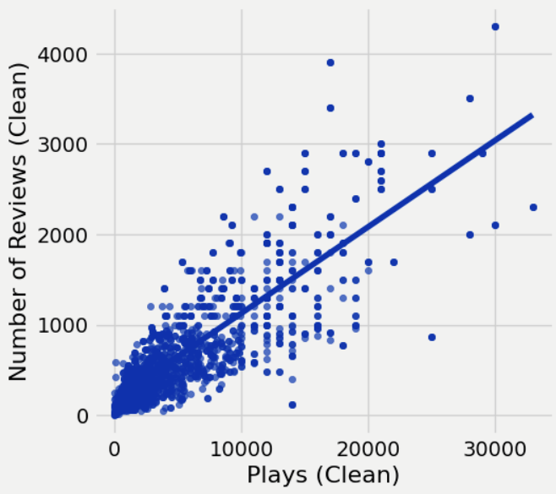
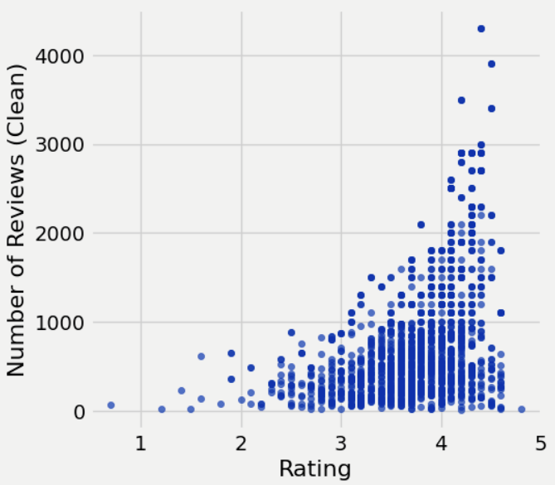
Casey’s Mini-Update 2
Number of plays has a strong correlation with number of reviews. It makes sense for this to be the case, since if more people have played a game, there are more people who may want to leave a review for it. Similarly, games with higher ratings tend to have more reviews. This could either mean that people are more likely to leave reviews for games that they like than games they dislike. It’s also possible that well-recieved games receive more reviews because they are more popular.

Slide 31

Camila’s Mini Update
This week I chose to answer the question “Which genres are the most popular among players?” I made a graph to answer this. In the visual, adventure takes first place with over 1000 games, and pinball comes last. RPG, shooter, and platform are also popular with 300~600 games. Most if not all games have multiple genres in their description and adventures shows up the most.
Notes:
One slide on progress
What has accomplished and what is the plan for next week
What are the obstacles that you need help
What kind of resources you have used
Contribution of each team member (for group)
One slide on feedback (if you received any from previous week)
tell us something about (1) the feedback you received;(2) if and how you address the feedback; (3) whether you feel the feedback is useful; (4) what additional feedback you are seeking

Slide 32
Progress
We have accomplished answering some of the questions this week which was our goal and we were successful in getting the answers for our questions. The plan for next week is to answer more of the questions but also start looking at patterns and similarities. An obstacle is probably the large amount of data but so far we haven’t had any trouble with the questions so far. We have used jupyterhub to write the codes to actually figure out the answers to our questions.

Slide 33
Week 1

Slide 34
Dataset Information
1512 Rows
14 Columns
The “Team,” “Genres,” and “Reviews” columns contain multiple column delimited strings. To gather useful data about these attributes, it will be necessary to perform operations on the data. The “Reviews” column will likely not be useful, so cleaning it is unnecessary.

Slide 35
Column Analysis pt.1
Column Name | Has missing value? | Data type (discrete or number or free text) | Useful? | Needs cleaning or processing?
Untitled (Row Number) | No | Discrete | No | No
Title | No | Free Text | Yes | No
Release Date | No | Number | Yes | Yes
Team | No | Free Text | Yes | Yes
Rating | No | Number | Yes | No
Times Listed | No | Discrete | Yes | No
Number of Reviews | No | Discrete | Yes | No

Slide 36
Column Analysis pt. 2
Column Name | Has missing value? | Data type (discrete or number or free text) | Useful? | Needs cleaning or processing?
Genres | No | Free Text | Yes | Yes
Summary | No | Free Text | No | No
Reviews | No | Free Text | No | No
Plays | No | Discrete | Yes | Yes
Playing | No | Discrete | Yes | No
Backlogs | No | Discrete | Yes | No
Wishlist | No | Discrete | Yes | No

Slide 37
Potential Questions
Which genres have the highest average ratings?
Which genres are the most popular among players?
Which genres have the greatest disparity between player count and ratings?
Which genres have the lowest and highest difference between player count and review count?
How does rating correlate with player count?
Does number of backlogs correlate more closely with popularity or with rating?
Which genres have the highest proportion of backlogs compared to plays?

Slide 38
Audience & Goals
The intended audience for our analysis will be people who play video games. Our goal will be to inform and possibly change perspectives on genres and potentially encourage people who play video games to step outside their comfort zones and try unfamiliar genres of games.

